Slide 1
PLANT DISEASE DETECTION USING CONVOLUTIONAL NEURAL NETWORK
UMBC DATA 606 CAPSTONE PROJECT BY:
RASHMINI AKKAPALLY
EG10774
Under Guidance of Prof. Dr. Chaojie Wang

Slide 2

INTRODUCTION
Project aims to detect plant diseases using images of plant leaves and provide solutions or precautions for the detected disease.
Web application for easy user access –built with streamlit.
Allows users to upload leaf images for analysis
CNN model identifies plant health status
Supports early detection to reduce crop loss.

Slide 3
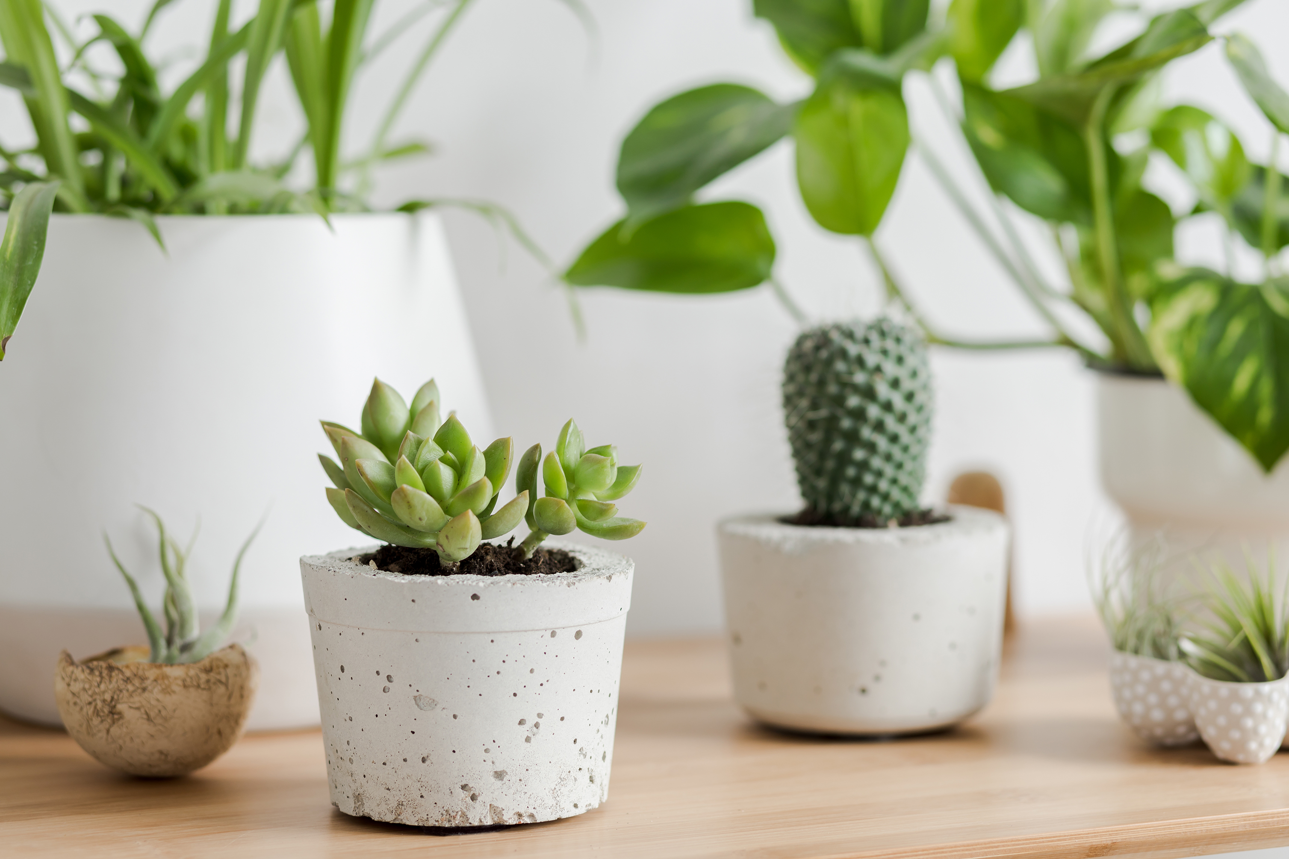
PROBLEM SIGNIFICANCE
Plant diseases cause crop loss and impact food security
Early detection reduces spread and improves crop health
Supports sustainable agriculture and rural economies

Slide 4
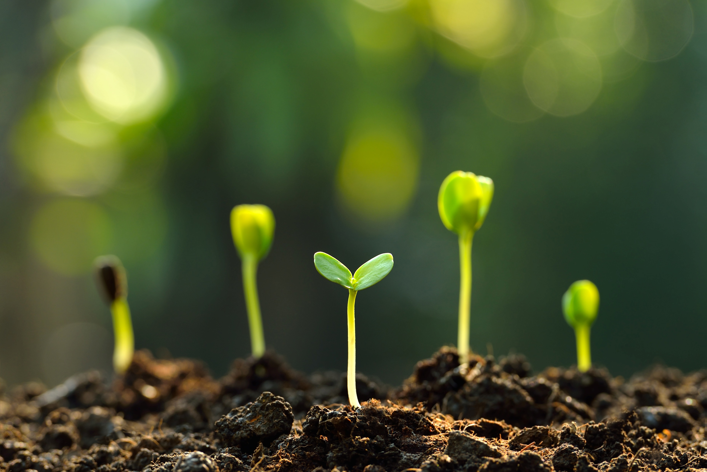
RESEARCH QUESTIONS
Can machine learning effectively classify healthy and diseased plant leaves using image data?
What level of accuracy can be achieved using deep learning techniques such as Convolutional Neural Networks (CNNs)?
What are the most effective image preprocessing techniques for enhancing the accuracy of plant disease detection?

Slide 5

TOOLS/SOFTWARE USED :
Google Colab pro
Visual Studio Code
Tensorflow/Keras
Streamlit
Python
Pandas/NumPy

Slide 6

DATA OVERVIEW
Data source:
The PlantVillage Dataset, available on Kaggle: PlantVillage Dataset on Kaggle This dataset consists of over 50,000 expertly curated images of healthy and diseased leaves from various crop plants.
Data size
Approximately 4 GB
Data shape
Number of images: 54,305 images
Image dimensions: 256x256 pixels

Slide 7
Exploratory Data Analysis
The PlantVillage dataset is organized into three folders:
grayscale: Contains black and white versions of the images.
segmented: Contains images with segmented plant parts.
color: Contains RGB color images of plant leaves.(considered this set for building the model)
Each folder contains subfolders representing different plant species and their associated diseases.

Slide 8
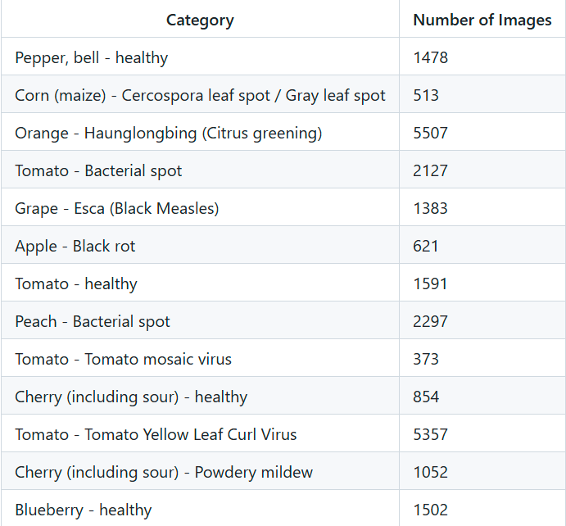
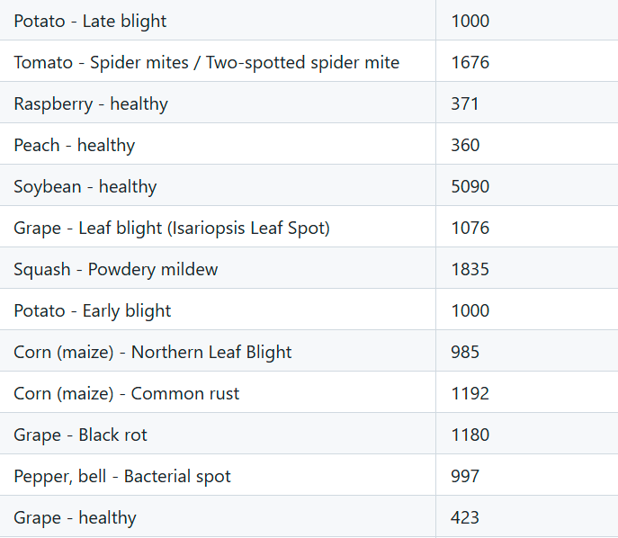
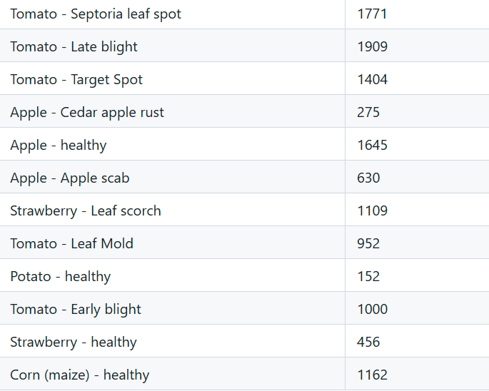
EDA Contd.
There are a total of 38 categories(14 different plant species), including both healthy and diseased plants.

Slide 9
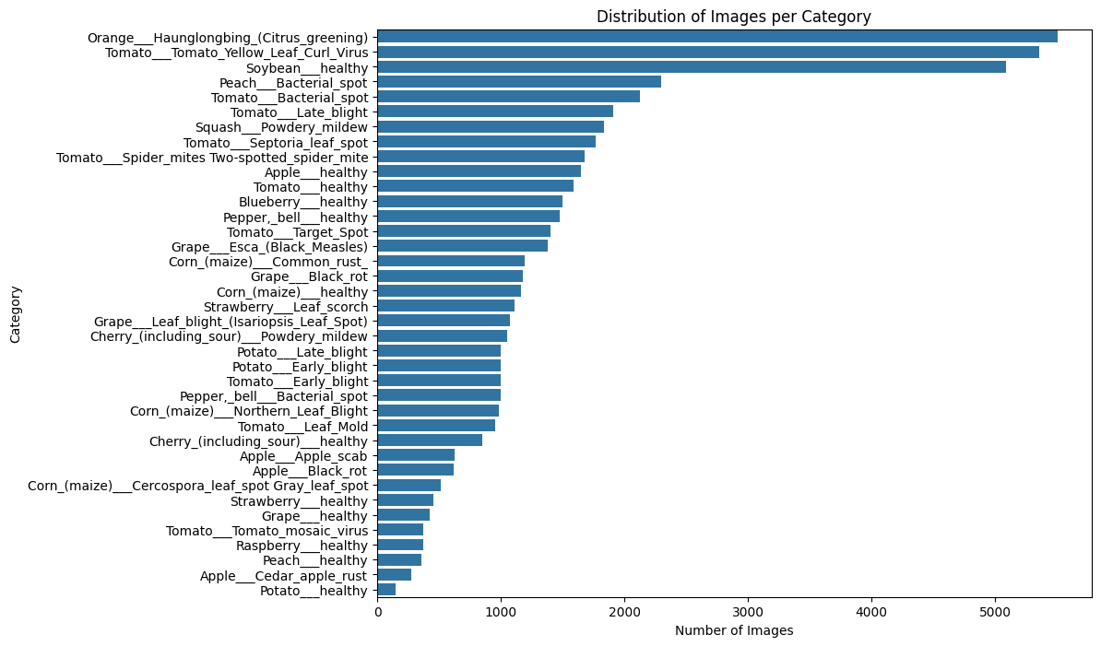
DATA VISUALIZATION

Slide 10

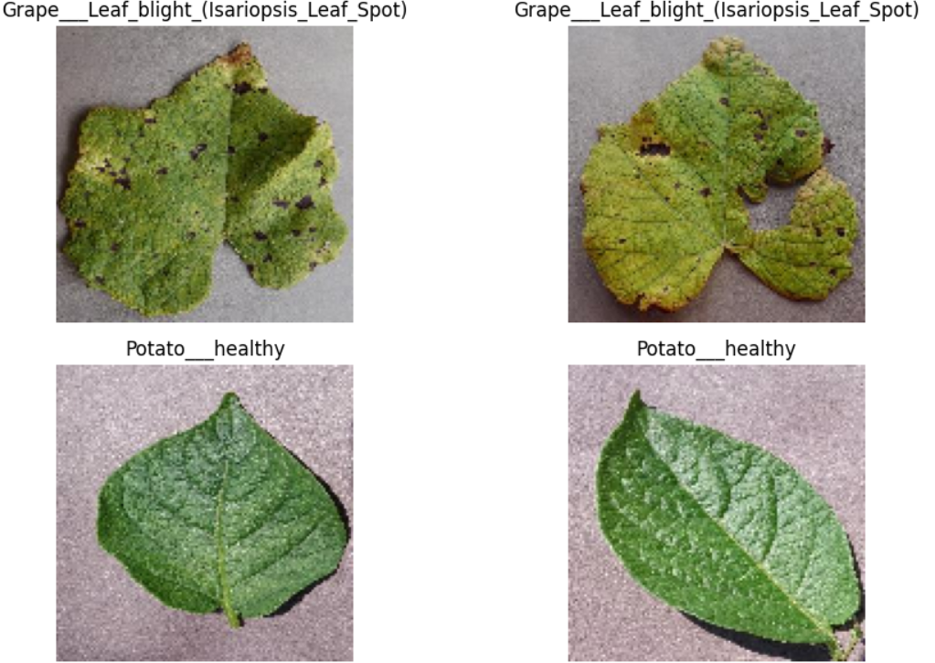
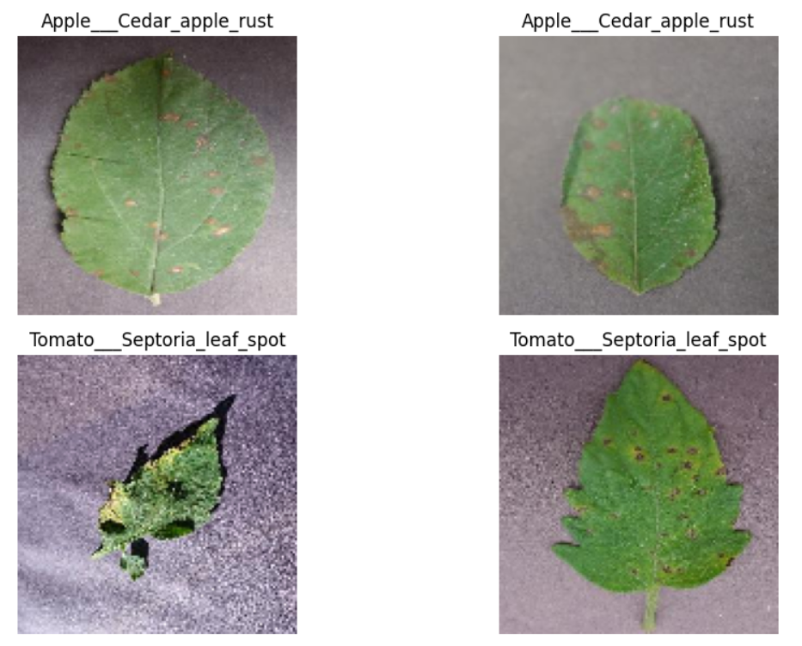
SAMPLE IMAGES

Slide 11
DATA AUGMENTATION AND DATA SPLITTING
Data Splitting:
Split data into: 80% Training, 20% Testing
Further split training set into: 80% Training, 20% Validation
Results in three datasets:
Training Set: For model learning
Validation Set: For tuning model performance
Test Set: For final evaluation
Data Augmentation:
Expands dataset size with transformations:
Techniques: Rotation, shifting, shearing, zooming, flipping
Improves model generalization and reduces overfitting

Slide 12

MODEL TRAINING
used both CNN model and ResNet for plant disease detection.
CNN model effectively captured disease patterns with less complexity compared to ResNet
The model was trained for 20 epochs using the training dataset, with the validation dataset used to monitor generalization.

Slide 13

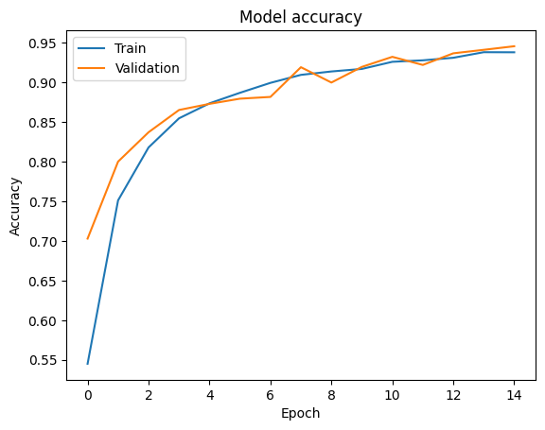
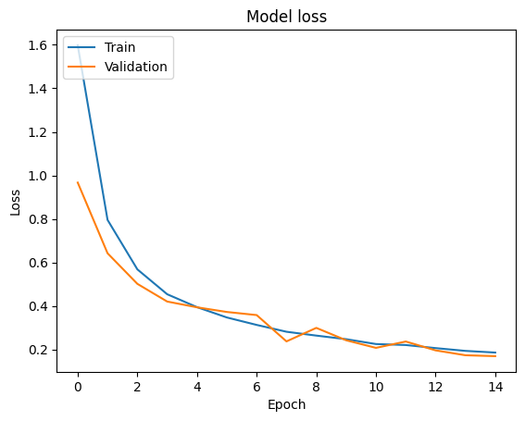
Performance Metrics Visualization
Final Validation Accuracy: 94.54%
Final Validation Loss: 0.1780

Slide 14

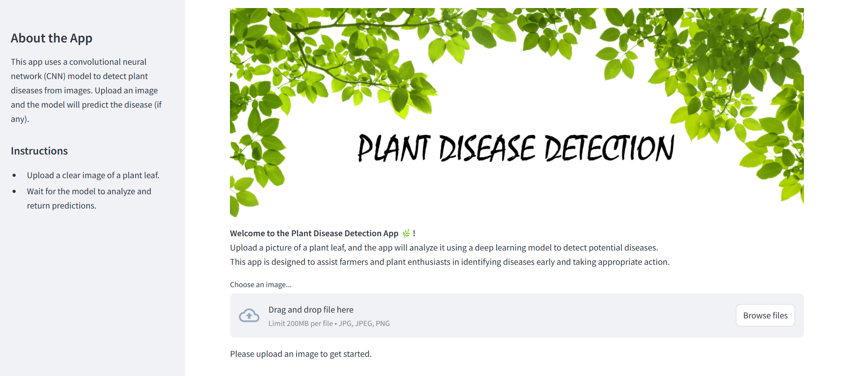
Web App Using Streamlit Link : https://plantdiseasedetection-rashmini-capstone.streamlit.app/

Slide 15

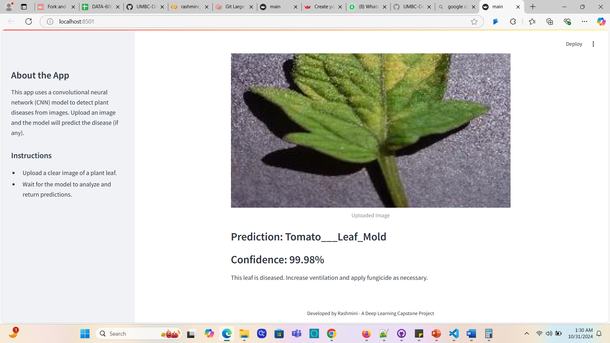
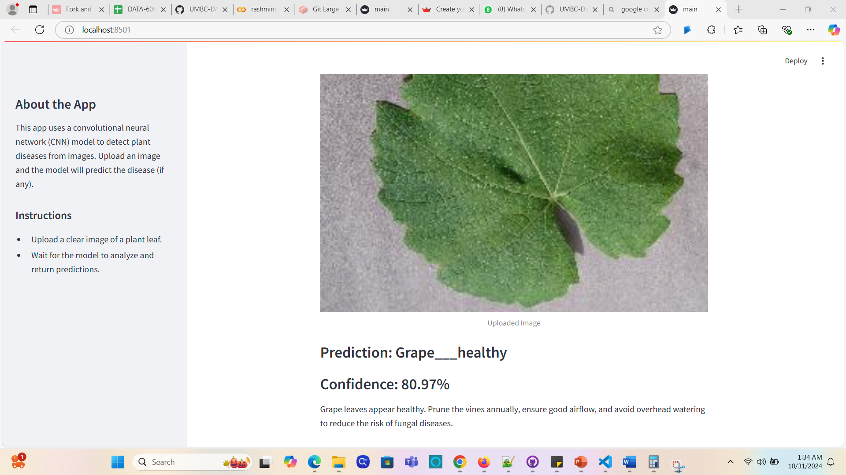
Results

Slide 16
CONCLUSION
Objective Achieved: Demonstrated plant disease detection using CNN with high accuracy.
High Validation Accuracy: Achieved 94.54% on the PlantVillage dataset.
User-Friendly Web App: Implemented in Streamlit for easy access.
Impact: Supports early disease detection, potentially reducing crop loss and improving productivity.

Slide 17

FUTURE WORK
Integration of Larger Datasets
LLM Integration for Enhanced User Support

Slide 18
REFERENCES
Hassan SM, Maji AK, Jasiński M, Leonowicz Z, Jasińska E. Identification of Plant-Leaf Diseases Using CNN and Transfer-Learning Approach. Electronics. 2021; 10(12):1388. https://doi.org/10.3390/electronics10121388
M. Shobana et al., "Plant Disease Detection Using Convolution Neural Network," 2022 International Conference on Computer Communication and Informatics (ICCCI), Coimbatore, India, 2022, pp. 1-5, doi: 10.1109/ICCCI54379.2022.9740975.
Web App Development Made Simple with Streamlit (2024) Google Books. Available at: https://books.google.com/books?id=pLfuEAAAQBAJ&dq=webapp+using+streamlit&lr=&source=gbs_navlinks_s (Accessed: 31 October 2024).

Slide 19
THANK YOU ANY QUESTIONS?

